Slide 1
Introduction to Groovy
Groovy is ...
An agile dynamic language for the Java Platform with many features that are inspired by languages like Python, Ruby and Smalltalk, making them available to Java developers using a Java-like syntax.
RJUG - Introduction to Groovy - Presented by Andrew Branch

Slide 2
Scripting Languages
The old new new thing…
Productivity / Rapid Development / Agile
Interpreted (No Compile Cycle)
Expressive - Shorter, Less Verbose Syntax
Feature Rich yet Simple and Productive
Shell / System Integration / Systems “Glue”
Dynamic
Open Source – also code available by default
Advanced languages features Closures / Mix Ins
RJUG - Introduction to Groovy - Presented by Andrew Branch

Slide 3
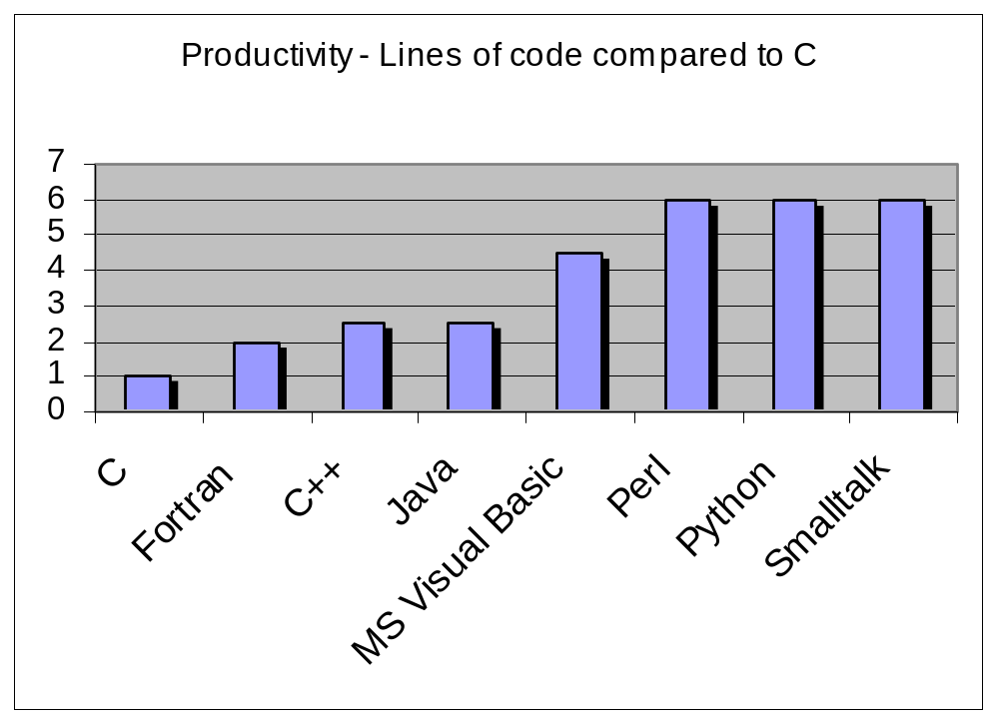
Scripting Languages – Productivity
From “Code Complete” by Steve McConnell
RJUG - Introduction to Groovy - Presented by Andrew Branch

Slide 4
Scripting Languages – The Reputation
Weakly Typed
Procedural
Scalability / Enterprise Ready
Not Maintainable – (Perl)
Lack of threading support
Lack of IDE / Debugger support
Cross Platform Support
Performance
Specialized / Not general purpose
RJUG - Introduction to Groovy - Presented by Andrew Branch

Slide 5
Scripting Languages – The Reality
The lines are blurring between scripting and traditionally compiled languages. This trend will continue.
Programmer adoption going up, up, up.
Ruby on Rails, PHP are popular, powerful, productive and cool.
Many now target a Java VM’s (JRuby, Jython, ABCL) or Perl targets Parrot.
Optimize developer time over execution time.
The right tool for the right job.
RJUG - Introduction to Groovy - Presented by Andrew Branch

Slide 6
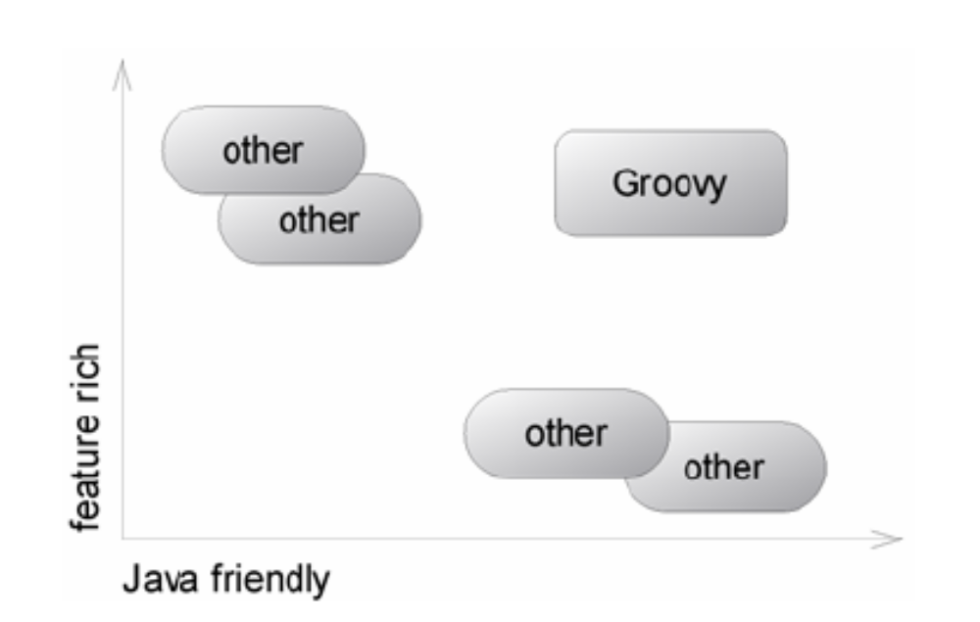
Groovy – In the Sweet Spot
Groovy is feature rich and java friendly
RJUG - Introduction to Groovy - Presented by Andrew Branch

Slide 7
Groovy - Overview
Syntactically very close to Java
Leverages investment in Java
Interpreted-ish. .groovy files fully parsed and classes are generated on the fly, via a custom class loader.
Can be compiled and fully integrated with traditional Java application.
Language level support for lists, maps, regular expressions.
Supports closures, dynamic typing, meta object protocol.
RJUG - Introduction to Groovy - Presented by Andrew Branch

Slide 8
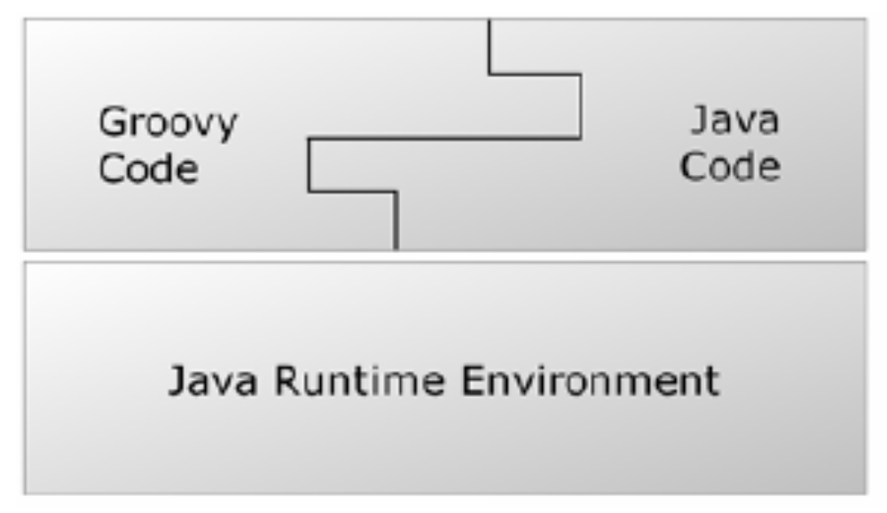
Groovy & Java – Seamless Integration
Groovy code co-exists with Java Code and runs in the JRE.
Syntax nicely aligned with Java.
RJUG - Introduction to Groovy - Presented by Andrew Branch

Slide 9
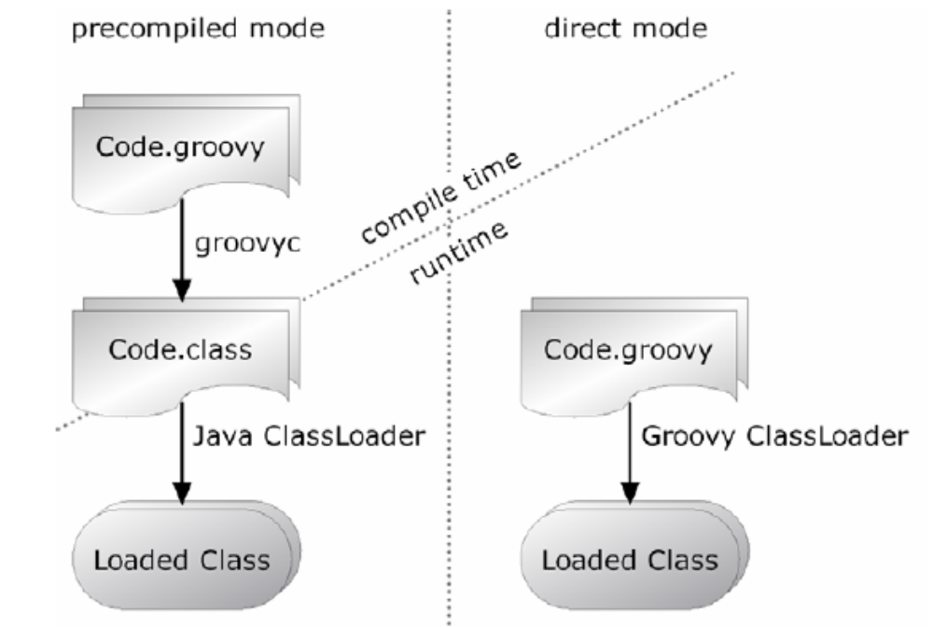
Direct or Precompiled Modes
RJUG - Introduction to Groovy - Presented by Andrew Branch

Slide 10
Groovy – Current Situation
Standards Supported - JSR-241 - Groovy is the 2nd standard language for the Java platform, with Java being the first.
Still in Beta – Jsr-6 (released: end of June 2006)
RC1 – The first release candidate of the Reference Implementation – was due end of August 2006.
Pretty stable but wouldn’t bet my job on it.
Error messages still hard to decipher.
Documentation lacking.
Groovy in Action Book from Manning. 90% available for download via Early Access Program.
RJUG - Introduction to Groovy - Presented by Andrew Branch

Slide 11
Hello World – Groovy Style
println 'Hello Groovy'
To run type ‘groovy hello.groovy’
Parenthesis are optional
Ending semi-colons optional
Class declaration optional
Main entry point optional
Single Quotes or Double quotes for Strings. Groovy has several string styles.
System.out is assumed - Groovy automatically imports the packages groovy.lang.*, groovy.util.*, java.lang.*, java.util.*, java.net.*, and java.io.*
RJUG - Introduction to Groovy - Presented by Andrew Branch

Slide 12
Groovy Types
Everything is an object no primitive types.
Primitive types are auto boxed
Optional Typing – If not explicitly specified assumed to be java.lang.Object
Type safe – Unlike some scripting languages, Groovy doesn’t allow one type to be treated as another without a well defined conversion being available.
RJUG - Introduction to Groovy - Presented by Andrew Branch

Slide 13
Types Example
a = 1 // Implicit typing to Integer
b = 'howdy' // Implicit typing to String
int c = 33 // Explicit typing to Integer
def d = 5.2f // def keyword means any type
println 'a is ' + a.class.name
println 'b is ' + b.class.name
println 'c is ' + c.class.name
println 'd is ' + d.class.name // class name as property
Output
a is java.lang.Integer
b is java.lang.String
c is java.lang.Integer
d is java.lang.Float
RJUG - Introduction to Groovy - Presented by Andrew Branch

Slide 14
Operator Overloading
Operator | Method
a + b | a.plus(b)
a – b | a.minus(b)
a * b | a.multiply(b)
a / b | a.div(b)
a % b | a.mod(b)
a++ or ++a | a.next()
a-- or --a | a.previous()
a**b | a.power(b)
a | b | a.or(b)
a&b | a.and(b)
a^b | a.xor(b)
~a | a.negate()
a[b] | a.getAt(b)
a[b] = c | a.putAt(b, c)
Operator | Method
a << b | a.leftShift(b)
a >> b | a.rightShift(b)
a >>> b | a.rightShiftUnsigned(b)
switch(a){ case b: } | b.isCase(a)
a == b | a.equals(b)
a != b | ! a.equals(b)
a <=> b | a.compareTo(b)
a > b | a.compareTo(b) > 0
a >= b | a.compareTo(b) >= 0
a < b | a.compareTo(b) < 0
a <= b | a.compareTo(b) <= 0
RJUG - Introduction to Groovy - Presented by Andrew Branch

Slide 15
Strings
Single Quotes – java.lang.String
Double Quotes – groovy.lang.GString – Allow replacement of ${vars}
Triple Single Quotes – Multi Line Strings, Newlines always \n, Whitespace preserved.
Triple Double Quotes – Multi Line GStrings
Forward Slash – Escape backslashes ignored, makes Regular Expressions more readable
RJUG - Introduction to Groovy - Presented by Andrew Branch

Slide 16
String Example
me = 'Tarzan'
you = 'Jane'
line = "me ${me} - you $you"
assert line == 'me Tarzan - you Jane'
// Note abbrev dollar syntax $you
// Note == is equality not identity
date = new Date(0)
out = "Year $date.year Month $date.month Day $date.date"
assert out == 'Year 70 Month 0 Day 1'
out = "Date is ${date.toGMTString()} !"
assert out == 'Date is 1 Jan 1970 00:00:00 GMT !'
// Note $date.month access month property
RJUG - Introduction to Groovy - Presented by Andrew Branch

Slide 17
String Example Continued
// Multi line
sql = """
SELECT FROM MyTable
WHERE Year = $date.year
"""
// Literal dollar sign
out = "my 0.02\$"
// Slashy Strings, don't need to escape
assert "abc" == /abc/
assert "\\d" == /\d/
RJUG - Introduction to Groovy - Presented by Andrew Branch

Slide 18
Regular Expressions
Find Operator: =~
Creates a matcher.
Match Operator: ==~
Matches a regular expression.
Pattern Operator: ~String
Creates a pattern from a string.
RJUG - Introduction to Groovy - Presented by Andrew Branch

Slide 19
Regular Expression Example
// Find operator
assert "aaa1bbb2ccc3" =~ /bbb/
// Match operator – must match entire string
assert "aaa1bbb2ccc3" ==~ /(...\d)*/
// Patterns
def p = ~/a*b/
assert p instanceof Pattern
def m = p.matcher("aaaaab");
assert m.matches()
RJUG - Introduction to Groovy - Presented by Andrew Branch

Slide 20
Ranges
Specify an upper and lower bound of some sequence.
Can be used to replace:
  if (a >= 0 && a <= upperBound) {
  // do something with a
  }
Ranges are Objects
lowerbound..upperbound: inclusive
Lowerbound..<upperbound: half inclusive
Supports Numbers, Strings, Dates, Reverse Ranges.
Can create your own, by overriding next(), previous() and implements Comparable
RJUG - Introduction to Groovy - Presented by Andrew Branch

Slide 21
Ranges Example
assert (0..10).contains(0)
assert (0..10).contains(5)
assert (0..10).contains(10)
assert (0..10).contains(-1) == false
assert (0..10).contains(11) == false
assert (0..<10).contains(9)
assert (0..<10).contains(10) == false
assert ('a'..'c').contains('b')
log = ''
// Replacement for Java for statements.
for (element in 5..9){
log += element
}
assert log == '56789'
RJUG - Introduction to Groovy - Presented by Andrew Branch

Slide 22
Lists and Maps
Groovy has language level support for maps
Lists specified with [item, item, item] syntax
java.util.ArrayList under the hood
Maps specified with [name1:value, name2:value, name3:value] syntax
java.util.HashMap under the hood.
Use [ ] operator to access.
Define closures to ease iteration.
RJUG - Introduction to Groovy - Presented by Andrew Branch

Slide 23
Lists - Specifying
myList = [1,2,3]
assert myList.size() == 3
assert myList[0] == 1
assert myList instanceof ArrayList
emptyList = []
assert emptyList.size() == 0
longList = (0..1000).toList()
assert longList[555] == 555
explicitList = new ArrayList()
explicitList.addAll(myList)
assert explicitList.size() == 3
explicitList[0] = 10
assert explicitList[0] == 10
RJUG - Introduction to Groovy - Presented by Andrew Branch

Slide 24
Lists – Overloaded Subscript Operator
myList = ['a','b','c','d','e','f']
assert myList[0..2] == ['a','b','c'] // getAt(Range)
assert myList[0,2,4] == ['a','c','e'] // getAt(Index Collection)
// putAt(Range)
myList[0..2] = ['x','y','z']
assert myList == ['x','y','z','d','e','f']
myList[3..5] = []
assert myList == ['x','y','z']
myList[1..1] = ['y','1','2']
assert myList == ['x','y','1','2','z']
RJUG - Introduction to Groovy - Presented by Andrew Branch

Slide 25
Lists – Negative Indexes
Count from the back of the list. The last index is -1.
Can be used with ranges.
list[-3..-1] gives you the last three entries.
list[1..-2] to cut away the first and the last entry.
RJUG - Introduction to Groovy - Presented by Andrew Branch

Slide 26
Lists – Adding and Removing
myList = []
myList += 'a' // plus(Object)
assert myList == ['a']
myList += ['b','c'] // plus(Collection)
assert myList == ['a','b','c']
myList = []
myList << 'a' << 'b' // leftShift is like 'append'
assert myList == ['a','b']
assert myList - ['b'] == ['a'] // Minus to remove
RJUG - Introduction to Groovy - Presented by Andrew Branch

Slide 27
Lists – GDK Methods
Groovy Development Kit adds many methods to the collection classes.
Many take closures to perform some operation on the collection
Examples: min, max, sort, sum, collect, each, find, unique etc…
RJUG - Introduction to Groovy - Presented by Andrew Branch

Slide 28
Lists Iteration with Closures
def list = [1,2,3]
// Find even numbers
def even = list.find {item -> item % 2 == 0}
assert even == 2
// Is every number less than 5?
assert list.every { item -> item < 5}
// Is any number less than 2
assert list.any { item -> item < 2}
// Append each item to store
def store = ''
list.each { item -> store += item }
assert store == '123'
RJUG - Introduction to Groovy - Presented by Andrew Branch

Slide 29
Maps - Specifying
def myMap = [a:1, b:2, c:3]
assert myMap instanceof HashMap
assert myMap.size() == 3
assert myMap['a'] == 1
def emptyMap = [:]
assert emptyMap.size() == 0
def explicitMap = new TreeMap()
explicitMap.putAll(myMap)
assert explicitMap['a'] == 1
RJUG - Introduction to Groovy - Presented by Andrew Branch

Slide 30
Maps - Access
def myMap = [a:1, b:2, c:3]
// retrieve
assert myMap['a'] == 1
assert myMap.a == 1
assert myMap.get('a') == 1
assert myMap.d == null
assert myMap.get('d',0) == 0
assert myMap.d == 1 // now it's there
// assign
myMap['d'] = 1
assert myMap.d == 1
myMap.d = 2
assert myMap.d == 2
RJUG - Introduction to Groovy - Presented by Andrew Branch

Slide 31
Maps - Iteration
def myMap = [a:1, b:2, c:3]
// Dump contents by each entry
myMap.each {entry ->
println "$entry.key = $entry.value"
}
// Dump contents by each key/value
myMap.each {key, value ->
println "$key = $value"
}
// Dump contents by for
for (key in myMap.keySet())
println "$key = " + myMap[key]
RJUG - Introduction to Groovy - Presented by Andrew Branch

Slide 32
Closures
A powerful and integral feature of Groovy. You won’t be able to avoid them.
Essentially a block of code wrapped in an object.
Similar to anonymous inner classes in Java but less verbose and more flexible.
Aka C# Delegate, Lisp Lambda, C function pointers.
Useful for iteration, using resources safely.
Avoids interface proliferation (Runnables, Observers, Listeners, Visitors, Comparators, Strategies, Commands, Controllers)
Have access to local variables without having to make them final as Java anonymous inner classes require.
Proposal from Gosling and others to add Closures to Java 7.
RJUG - Introduction to Groovy - Presented by Andrew Branch

Slide 33
Closures - Specifying
def list = [1,2,3]
// Closure to print contents of a list
def closure = { x -> println x }
list.each(closure)
// Simplify 1 - Create closure within each
list.each({ x -> println x })
// Simplify 2 - () not required if closure last param
list.each { x -> println x }
// Simplify 3 - 'it' is default parameter name if one param
list.each { println it }
RJUG - Introduction to Groovy - Presented by Andrew Branch

Slide 34
Closures - Calling
// Create a closure
def adder = { x, y -> return x + y }
// Call it using the call method
assert adder.call(2, 6) == 8
// Abbreviated call
assert adder(4, 3) == 7
// In a method
void adjustSalary(Closure adjustment) {
for(e in employees) {
adjustment(e)
}
}
RJUG - Introduction to Groovy - Presented by Andrew Branch

Slide 35
Groovy Truth
Broader than Java which just uses Boolean tests to determine truth.
Boolean | Corresponding boolean value is true
Matcher | The matcher has a match
Collection | The collection is non-empty
Map | Whether the map is non-empty
String | The string is non-empty
Number | The number is non-zero
None of the above | The object reference is non-null
RJUG - Introduction to Groovy - Presented by Andrew Branch

Slide 36
Switch Statement
An object that defines isCase method can be the candidate of a switch statement.
All of the standard Java classes have isCase defined.
Object | a.equals(b)
Class | a.isInstance(b)
Collection | a.contains(b)
Range | a.contains(b)
Pattern | a.matcher(b.toString()).matches()
String | (a==null && b==null) || a.equals(b)
Closure | a.call(b)
RJUG - Introduction to Groovy - Presented by Andrew Branch

Slide 37
Switch Statement Example
switch (10)
{
case 0 : assert false ; break
case 0..9 : assert false ; break
case [8,9,11] : assert false ; break
case Float : assert false ; break
case {it%3 == 0}: assert false ; break
case ~/../ : assert true ; break
default : assert false ; break
}
RJUG - Introduction to Groovy - Presented by Andrew Branch

Slide 38
Looping
Mostly the same as Java.
Standard Java for not supported.
Use for(x in 0..9) instead
Enhanced for loop, like Java 5 but uses in rather than ':' and doesn't requires lists to be templated.
In many cases, closures can be used instead.
RJUG - Introduction to Groovy - Presented by Andrew Branch

Slide 39
Exceptions
Mostly the same as java with the following differences.
Declaration of exceptions in method signatures is optional. (Even for checked exceptions)
You therefore don't have to catch checked exceptions, they just go up the call stack
RJUG - Introduction to Groovy - Presented by Andrew Branch

Slide 40
Classes
Classes defined very much like in Java.
Public by default
Default visibility (not public, protected or private) will automatically adds bean methods.
Defining member variable type is optional however can't stand alone.
Fields can be referenced with subscript operator myclass['myfield']
Can also customize the field access operator '.' via get / set overrides.
RJUG - Introduction to Groovy - Presented by Andrew Branch

Slide 41
Class – Field Access
class Counter {
public count = 0
}
def counter = new Counter()
// Using field access operator
counter.count = 1
// using subscript operator
def fieldName = 'count'
counter[fieldName] = 2
RJUG - Introduction to Groovy - Presented by Andrew Branch

Slide 42
Class – Overriding Field Access
class PretendFieldCounter {
public count = 0
Object get (String name) { return 'pretend value' }
void set (String name, Object value) { count++ }
}
def pretender = new PretendFieldCounter()
// Call get method via overridden '.' operator
assert pretender.isNoField == 'pretend value'
// Call set method via overriden '.' operator
pretender.isNoFieldEither = 'just to increase counter'
assert pretender.count == 1
RJUG - Introduction to Groovy - Presented by Andrew Branch

Slide 43
Method Declaration
Public by default
void returns can be omitted
Types in argument list can be omitted, Object assumed.
Dynamic dispatch used to resolve methods.
Defaults allowed in argument list.
Optionals parameters if last argument is Object[]
Common practice to use Maps for 'named' arguments.
RJUG - Introduction to Groovy - Presented by Andrew Branch

Slide 44
Method Example
class Summer {
def sumWithDefaults(a, b, c=0) { return a + b + c }
def sumWithOptionals(a, b, Object[] optionals) {
return a + b + optionals.inject(0) { sum, i -> sum += i }
}
def sumNamed(Map args) {
['a','b','c'].each{ args.get( it, 0 ) }
return args.a + args.b + args.c
}
}
def summer = new Summer()
assert 2 == summer.sumWithDefaults(1,1)
assert 3 == summer.sumWithDefaults(1,1,1)
assert 2 == summer.sumWithOptionals(1,1)
assert 3 == summer.sumWithOptionals(1,1,1)
assert 2 == summer.sumNamed(a:1, b:1)
assert 1 == summer.sumNamed(c:1)
RJUG - Introduction to Groovy - Presented by Andrew Branch

Slide 45
Safe Dereferencing
The ?. operator can be used to safely dereference member variables without worring about null pointer exceptions.
When the reference before that operator is a null reference, the evaluation of the current expression stops and null is returned.
def map = [a:[b:[c:1]]]
// Normal . operator
assert map.a.b.c == 1
// Safe dereferencing
assert map?.a?.x?.c == null
RJUG - Introduction to Groovy - Presented by Andrew Branch

Slide 46
Constructors
Public by default
If implicit can construct in 2 ways
  Empty constructor
  Named params
If explicit can construct in 3 ways
  Traditional Java
  Using as keyword
  Implicit type conversion
emp = new Employee()
emp = new Employee(name: 'Bob', age: 32)
class Employee {
def name
def age
}
emp = new Employee('Bob', 32)
emp2 = ['Joe', 41] as Employee
Employee emp3 = ['Tom', 50]
class Employee {
Employee(name, age) {
this.name = name; this.age = age
}
def name
def age
}
RJUG - Introduction to Groovy - Presented by Andrew Branch

Slide 47
.groovy Files
If a .groovy file contains no class, it becomes a class of type Script using the filename as the class name. main automatically added.
If it contains exactly one class with same name as file, then 1 to 1 relationship as in Java.
Can contain multiple classes of any visibility
Can mix scripting code and classes. No need to worry about ordering. Classes can be referenced before declared.
Groovy classloader will search for .groovy files on the classpath. Will only find classes where name matches file.
RJUG - Introduction to Groovy - Presented by Andrew Branch

Slide 48
Imports
By default groovy imports the following packages into all .groovy files
  import java.lang.*
  import java.util.*
  import java.io.*
  import java.net.*
  import groovy.lang.*
  import groovy.util.*
  import java.math.BigInteger
  import java.math.BigDecimal
Import can be used for 'type aliasing' using as keyword
import thirdparty.Element as Element2
RJUG - Introduction to Groovy - Presented by Andrew Branch

Slide 49
Multimethods
Groovy takes dynamic type of arguments into account when resolving methods. Java uses static type.
def oracle(Object o) { return 'object' }
def oracle(String o) { return 'string' }
Object x = 1
Object y = 'foo'
assert 'object' == oracle(x)
assert 'string' == oracle(y) // would return 'object' in Java
RJUG - Introduction to Groovy - Presented by Andrew Branch

Slide 50
GroovyBeans
Allows property access for all JavaBeans, defined in Java or Groovy. (myclass.myproperty)
Auto Generates get / set methods for properties members in groovy classes if member variables have default visibility.
Also get / set only generated if you have not already defined an accessor. This allows you to create read only or write only properties.
RJUG - Introduction to Groovy - Presented by Andrew Branch

Slide 51
GroovyBeans Example
class MyBean implements java.io.Serializable {
String foo, bar
// Make bar read only
String getBar() { return bar }
}
bean = new MyBean(foo: 'foo', bar: 'bar')
println bean.foo
bean.bar = 'error' // this won't be allowed
d = new Date()
println d.time // can access this as a property
RJUG - Introduction to Groovy - Presented by Andrew Branch

Slide 52
GroovyBean Properties
All properties in a bean can be accessed with property semantics.
class SomeBean {
int var1
String var2
Date var3
}
def bean = new SomeBean(var1: 1, var2: "foo", var3: new Date());
bean.properties.each { println it.key + " = " + it.value }
RJUG - Introduction to Groovy - Presented by Andrew Branch

Slide 53
Spread Dot Operator
'.*' use to access a property on each element in a list.
class Person {
Person(def name) { this.name = name }
def name
}
def list = [new Person('Bob'), new Person('Tom'),
new Person('Sal')]
// Java approach
for(Iterator i = list.iterator(); i.hasNext();)
System.out.println(((Person) i).getName());
// Closure
println list.collect{ p -> p?.name }
// Spread dot operator
println list*.name
RJUG - Introduction to Groovy - Presented by Andrew Branch

Slide 54
GPath
GPath is a construction in Groovy code that powers object navigation, analogous to XPath
Builds upon bean properties, closures, safe dereferencing operator and spread dot operator.
// Find all the 'get' methods in this class
println this.class.methods*.name.grep(~/get.*/).sort()
// Output
[getBinding, getClass, getMetaClass, getProperty]
RJUG - Introduction to Groovy - Presented by Andrew Branch

Slide 55
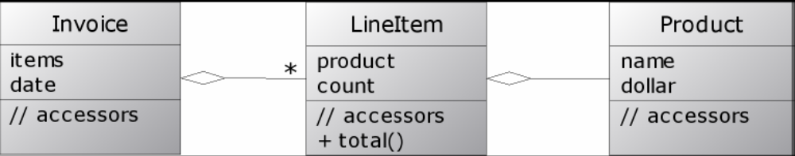
GPath Example2
Given the following model
class Invoice { List items; Date date }
class LineItem {
Product product; int count;
int total() {
return product.dollar * count
}
}
class Product { String name; def dollar}
RJUG - Introduction to Groovy - Presented by Andrew Branch

Slide 56
GPath Example2
You can perform GPath operations like the following.
// get the totals of all line items in all invoices
invoices.items*.total()
// find all product names with a line item totals > 7000
invoices.items.grep{it.total() > 7000}.product.name
RJUG - Introduction to Groovy - Presented by Andrew Branch

Slide 57
Mix In Categories
'use' keyword
Allows you to augment a class's available instance methods.
class Person {
Person(name, male) { this.name = name; this.male = male}
private def name
boolean male
}
// Add getTitle method to Person class
class PersonTitleCategory {
static String getTitle(Person self) {
if(self.male)
return 'Mr. ' + self.name
else
return 'Ms. ' + self.name
}
}
RJUG - Introduction to Groovy - Presented by Andrew Branch

Slide 58
Mix In Categories
kim = new Person('Kim', false);
bob = new Person('Bob', true);
println kim.name
println bob.name
use (PersonTitleCategory) {
println kim.title
println bob.title
}
Output:
Kim
Bob
Ms. Kim
Mr. Bob
RJUG - Introduction to Groovy - Presented by Andrew Branch

Slide 59
Meta Object Protocol
Allows you to change behavior of objects and classes at runtime.
Groovy has numerous inception points that let you override build in capabilities.
Allows for method interception for cross-cutting concerns (aspects) such as logging.
Redefine method call invocation to create Groovy Builders.
RJUG - Introduction to Groovy - Presented by Andrew Branch

Slide 60
GroovyObject
Every object in groovy implements GroovyObject
public interface GroovyObject {
public Object invokeMethod(String name, Object args);
public Object getProperty(String property);
public void setProperty(String property, Object newValue);
public MetaClass getMetaClass();
public void setMetaClass(MetaClass metaClass);
}
public class MetaObject {
// etc…
}
RJUG - Introduction to Groovy - Presented by Andrew Branch

Slide 61
MetaClass
Performs real work of method invocation
public class MetaClass {
Object invokeMethod(Object obj, String methodName,
Object args)
Object invokeMethod(Object obj, String methodName,
Object[] args)
Object invokeStaticMethod(Object obj, String methodName,
Object[] args)
Object invokeConstructor(Object[] args)
// etc…
}
RJUG - Introduction to Groovy - Presented by Andrew Branch

Slide 62
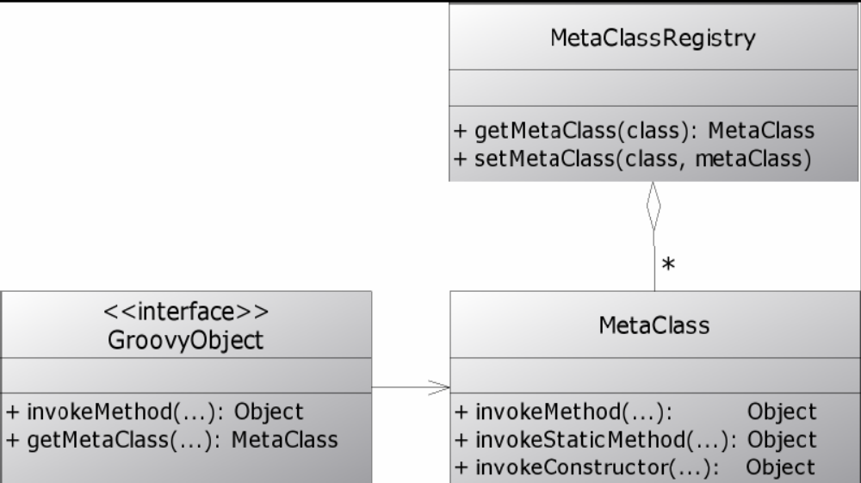
MetaClassRegistry
MetaClasses are stored in and retrieved from a central store, the MetaClassRegistry.
RJUG - Introduction to Groovy - Presented by Andrew Branch

Slide 63
Groovy Builders
Builders provide language level support to easily build hierarchies of objects. Useful for HTML, XML, File Systems, Swing, Test Cases, Data Models.
Gets away from addChild, setParent methods.
Work by overriding default behavior of method calls using Meta Object Protocol
RJUG - Introduction to Groovy - Presented by Andrew Branch

Slide 64
XML to Build
<?xml version="1.0"?>
<numbers>
<description>Squares and factors of 10..15</description>
<number value="10" square="100">
<factor value="2" />
<factor value="5" />
</number>
<number value="11" square="121" />
<number value="12" square="144">
<factor value="2" />
<factor value="3" />
<factor value="4" />
<factor value="6" />
</number>
etc…
</numbers>
RJUG - Introduction to Groovy - Presented by Andrew Branch

Slide 65
MarkupBuilder
def builder = new groovy.xml.MarkupBuilder()
builder.numbers {
description 'Squares and factors of 10..15'
for (i in 10..15) {
number (value: i, square: i*i) {
for (j in 2..<i) {
if (i % j == 0) {
factor (value: j)
}
}
}
}
}
method names specify xml elements
named method parameters specify attributes
closures specify nested elements
RJUG - Introduction to Groovy - Presented by Andrew Branch

Slide 66
AntBuilder
Uses builder semantics to create ant scripts.
Easily embed Ant within Groovy to easily add looping and conditionals to Ant.
Calls directly to Ant library, doesn't generate an XML file first.
IMO - Ant in Groovy is MORE readable than in XML files.
RJUG - Introduction to Groovy - Presented by Andrew Branch

Slide 67
From Ant to Groovy
<project name="prepareBookDirs" default="copy">
<property name="target.dir" value="target"/>
<property name="chapters.dir" value="chapters"/>
<target name="copy">
<delete dir="${target.dir}" />
<copy todir="${target.dir}">
<fileset dir="${chapters.dir}" includes="*.doc"
excludes="~*" />
</copy>
</target>
</project>
ANT
TARGET_DIR = 'target'
CHAPTERS_DIR = 'chapters'
ant = new AntBuilder()
ant.delete(dir:TARGET_DIR)
ant.copy(todir:TARGET_DIR){
fileset(dir:CHAPTERS_DIR, includes:'*.doc',
excludes:'~*')
}
Groovy
RJUG - Introduction to Groovy - Presented by Andrew Branch

Slide 68
Other Builders
SwingBuilder - Create JComponents hierarchies
NodeBuilder – Arbitray node data
MarkupBuilder – HTML or XML Markup
DOMBuilder – W3C Dom Tree
SAXBuilder
Create your own custom builder.
RJUG - Introduction to Groovy - Presented by Andrew Branch

Slide 69
Other Topics
Groovlets – Servlets in Groovy
GSP – Groovy Server Pages
Grails – Groovy's version of Ruby on Rails.
Integrating Groovy – Add groovy macros into your Java application.
Lots more XML manipulation – XmlParser, XmlSlurper
jUnit support
Windows / Com scripting via Scriptom
RJUG - Introduction to Groovy - Presented by Andrew Branch

